Slide 1

DVRS Consumer Satisfaction Surveys
Federal Fiscal Year 2026
(October 1st, 2025 – March 31st, 2026)
NJ Division of Vocational Rehabilitation Services & State Rehabilitation Council

Slide 2
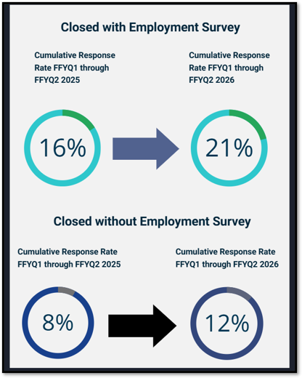
Survey Consumer Profile
  Participation in the Closed with Employment increased by 5% between FFY2025 to FFY2026 (Quarters 1 & 2)
  The response rate for the Closed without Employment survey increased by 4% between FFY2025 to FFY2026 (Quarters 1 & 2)

Slide 3
Completion Rate
Closed with Employment Survey | Complete | Incomplete | Total
Q2 | 101 | 34 | 135
Q1 | 47 | 25 | 72
Quarters combined | 148 | 59 | 207
Percentage combined | 71% | 29%
Closed without Employment Survey | Complete | Incomplete | Total
Q2 | 113 | 46 | 159
Q1 | 93 | 36 | 129
Quarters combined | 206 | 82 | 288
Percentage combined | 72% | 28%
  As illustrated above, the two surveys demonstrated similar completion and incompletion rates when both quarters were combined.
Notes:
Definitions of complete vs incomplete surveys according to survey monkey.
Complete: Answered all required questions and reached the end of the survey and clicked the final "Done" or "Submit" button.
Incomplete: Closes the survey browser or tab before clicking the final submit button. Leaves required questions unanswered (if the survey allows them to move forward) and drops off. Missing data was additionally not incorporated into the aggregated results.
There were 4 identified duplicates in the closed with employment survey, along with 3 identified duplicates in the closed without employment survey, but responses were mostly synonymous, so the data is not heavily skewed. Some respondents were able to attempt the survey 2 or 3 times because they were able to clear cookies, utilize a different browser or internet device, which therefore treats each respondent as a new person. QA is unaware if there are more duplicates than the ones identified as both surveys are anonymous and do not ask to identify respondents' names, unless they disclose at the end about wanting to follow up with DVRS services. We also want to get individuals validated responses, despite the duplicates, especially if their disability played into effect with them answering the questions properly.

Slide 4
I am (In Response to Those Filling Out the Survey):
Notes:
Average response rate was 99% for the question identifying who completed the survey across both closed case types (with and without employment).

Slide 5
Survey Feedback and Analysis

Slide 6
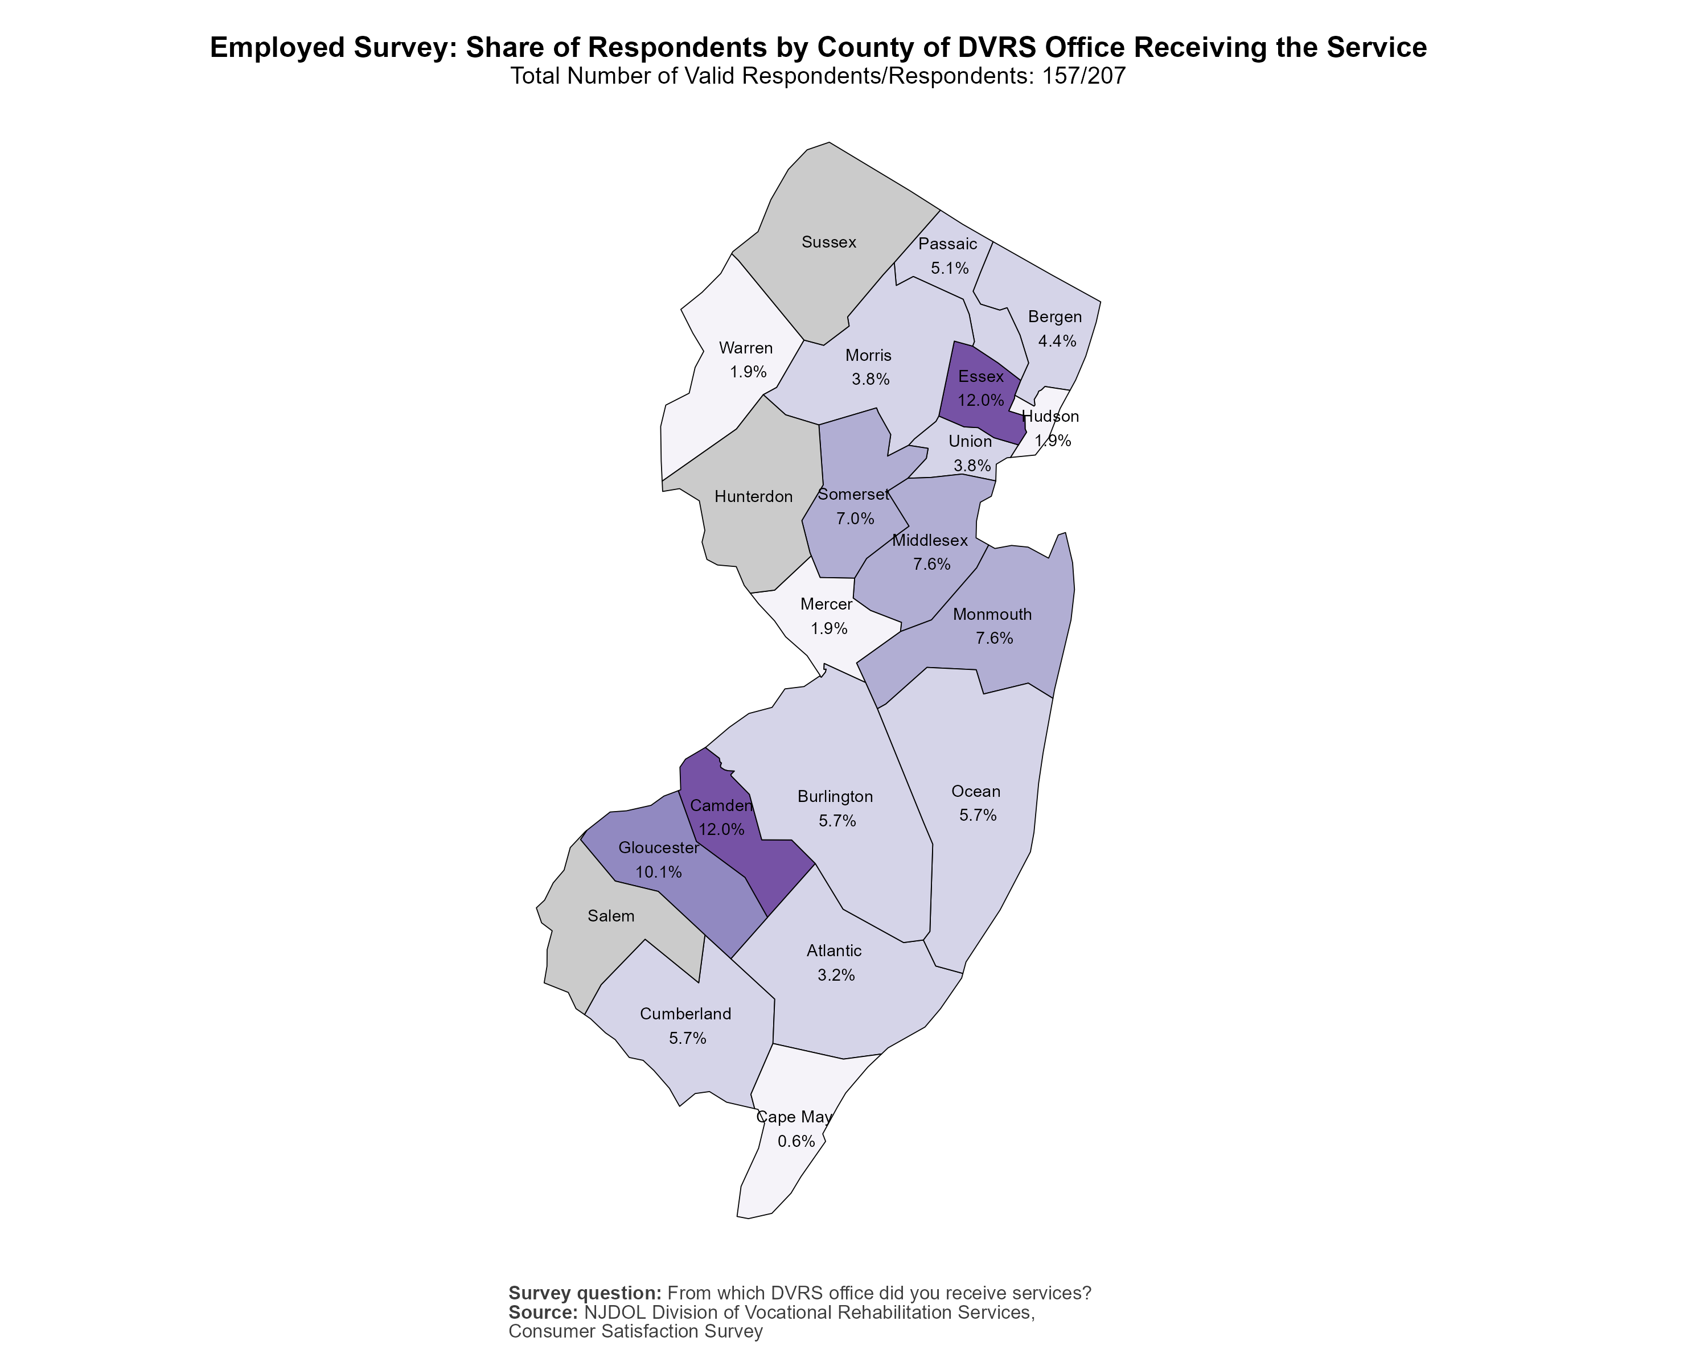
Respondents by County of DVRS Office Receiving the Service:
Closed with Employment
*Three counties are served through other DVRS offices:
Hunterdon (Somerset)
Salem (Cumberland)
Sussex (Warren)

Slide 7
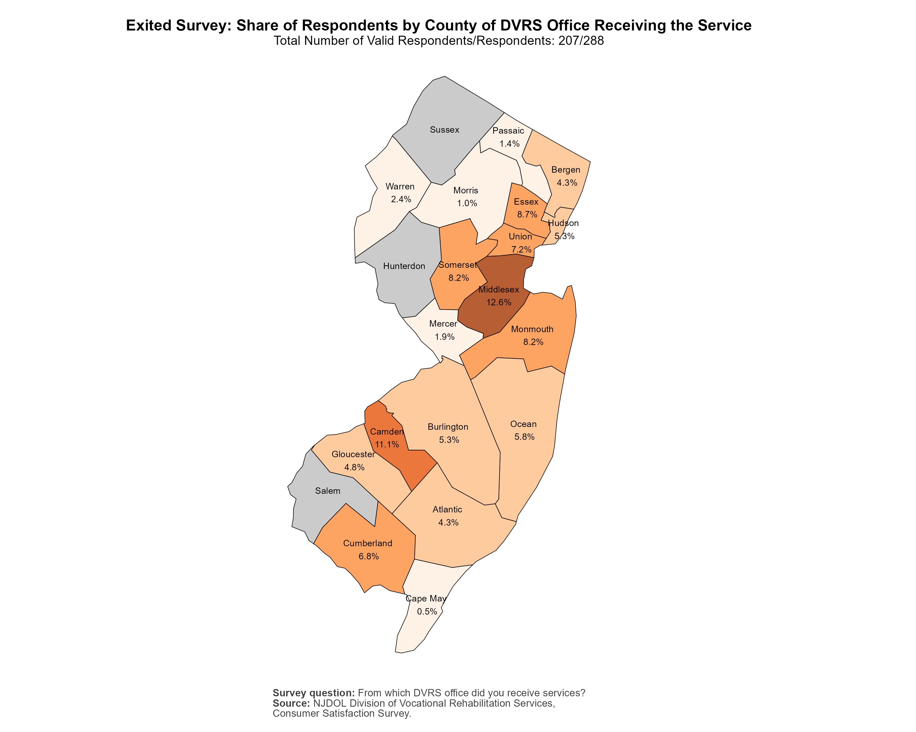
Respondents by County of DVRS Office Receiving the Service:
Closed without Employment
*Three counties are served through other DVRS offices:
Hunterdon (Somerset)
Salem (Cumberland)
Sussex (Warren)
Notes:
Average Response rate was 74% for the question identifying what office consumers received services across both closed case types (with and without employment).

Slide 8
What Is Your Age?
Notes:
Average Response rate was 65% for the question identifying what their age was across both closed case types (with and without employment).

Slide 9
What Is Your Gender?
Notes:
Average Response rate was 72% for the question identifying what their gender was across both closed case types (with and without employment) in the quantitative categories, and 0.3% for the qualitative categories.

Slide 10
What Is Your Primary Disability?
Notes:
Average response rate was 75% for the question identifying what their primary disability was across both closed case types (with and without employment).
For example, quantitative: (intellectual/developmental disability or cognitive & mobility).
Qualitative/Quantitative: Deaf/hard of Hearing, Open ended response: Autism
Qualitative only(open-ended): TBI, ADHD.
It was simpler to code this way in SPSS (stats program), rather than individually separating each disability out.

Slide 11
What Is Your Primary Disability (Other)?
Closed with Employment
Brain Injury (TBI)
Epilepsy
Head Injury
Lower Back Pain
Lupus
Autism
Substance Use Disorder
Closed without Employment
ADHD
Autism
Back Issues
Bronchial Asthma & Breathing Issues
Diabetes
Hearing Aids
Social Anxiety
Notes:
These are open-ended responses quoted directly from consumers.
Defined as having a single "other" disability, some disabilities were reclassified into other categories. Additionally, there are qualitative descriptions listed under multiple disabilities. Average response rate was 14% for the question identifying their primary disability (with and without employment) for the qualitative categories.

Slide 12
Demographics Summary
I am:
Closed with Employment: 76% of respondents who completed the survey were individuals who had received DVRS services.
Closed without Employment: 67% of respondents who completed the survey were individuals who had received DVRS services.
Field Office Serviced in:
Closed with Employment: 12% of respondents each reported they received services in Essex and Camden Counties.
Closed without Employment: 13% of respondents reported they received services in Middlesex County.
Age:
Closed with Employment: 46% of respondents who completed the survey identified being between 25-44.
Closed without Employment: 35% of respondents who completed the survey identified being between 25-44.
Based on the highest response rate from each question for each corresponding survey

Slide 13
Demographics Summary
Gender:
Closed with Employment: 59% of respondents who completed the survey identified as being male.
Closed without Employment: 55% of respondents who completed the survey identified as being male.
Race:
Closed with Employment & Closed without Employment: 44% of respondents from each survey identified as being white.
Disability:
Closed with Employment: 29% of respondents reported having multiple disabilities.
Closed without Employment: 34% of respondents reported having multiple disabilities.
Based on the highest response rate from each question for each corresponding survey

Slide 14
Average Satisfaction with DVRS Services
First Meeting with Staff Person at DVRS
The Amount of Time it Took to get DVRS Services
Participating in the Planning of My Services
The DVRS Counselor Followed My Planned Services
Overall Level of Satisfaction with My DVRS Services
This is based on an average for the following statements asked on a scale of
1 (Very Dissatisfied) to 5 (Very Satisfied)
This is the average response for all statements combined.
Notes:
Average response rate was 81% for average satisfaction with DVRS services across both closed case types (with and without employment).

Slide 15
Which Services from DVRS Helped You Find A Job?
Survey | Job Finding Services | Resume Assistance | Job Placement Services | Interview Assistance | Accommodations To Help with School or Work
Closed with Employment | 35% | 27% | 25% | 20% | 13%
As depicted in the charts to the left, respondents from each survey each indicated that Job Finding Services, Resume Assistance, Job Placement Services, and Interview Assistance were DVRS services that helped them find a job
Survey | Job Finding Services | Resume Assistance | Job Placement Services | Interview Assistance | Help with How Working Would Affect My SSI/SSDI
Closed without Employment | 24% | 18% | 16% | 13% | 13%
*Based on highest percentage of chosen responses
Circle indicates overlap in responses
Notes:
Closed Without Employment: Skip logic question based on a respondent who said, “yes” to being employed. Of the 288 respondents, 68 (24%) indicated they were employed. Due to this smaller subsample size, the following closed without employment-related findings regarding DVRS services should be interpreted with caution.

Slide 16
Did You Receive All The DVRS Services You Wanted/Needed?
Notes:
Average response rate was 80% for receiving all DVRS services you wanted/needed across both closed case types (with and without employment).

Slide 17
You Responded That You Did Not Receive All The DVRS Services You Wanted Or Needed:
What Services Did You Want Or Need That You Did Not Get?
Survey | Job Placement Services | Job Finding Services | Helping Pay for Trade School Or A Certification Course | Help Pay for College | Resume Assistance | Help with Getting Services from Other Agencies
Closed with Employment | 48% | 45% | 30% | 23% | 23% | 23%
As depicted in the charts to the left, respondents from each survey each indicated that job finding services, job placement services, help with getting services from other agencies, and helping pay for trade school or a certification course were DVRS services they wanted or needed, but did not get.
Survey | Job Finding Services | Job Placement Services | Help with Getting Services from Other Agencies | Help with Transportation | Accommodations To Help with School or Work | Helping Pay for Trade School Or A Certification Course
Closed without Employment | 46% | 45% | 37% | 33% | 32% | 30%
*Based on highest percentage of chosen responses
Circle indicates overlap in responses
Notes:
Closed With Employment: Skip logic question based on a respondent who said, “no” of receiving all the DVRS services you wanted/needed. Of the 207 respondents, 44 (21%) indicated they did not receive all the they wanted or needed. Due to this smaller subsample size, the following closed with employment-related findings regarding DVRS services respondents did not get should be interpreted with caution.

Slide 18
I Knew Who To Contact If I Needed Help (Or Was Unhappy) with My DVRS services
Notes:
Average response rate was 80% for knowing who contact if needed help or was unhappy with DVRS services across both closed case types (with and without employment).

Slide 19
DVRS Services Summary
DVRS Satisfaction Average:
Closed with Employment: Respondents reported an average of 4.23 out of 5 with satisfaction pertaining to DVRS services.
Closed without Employment: Respondents reported an average of 3.42 out of 5 with satisfaction pertaining to DVRS services.
Services from DVRS Help Find a Job:
Closed with Employment: 35% of respondents reported that job finding services helped them find a job.
Closed without Employment: 24% of respondents reported that job finding services helped them find a job.
Receive All the DVRS Services You Wanted/Needed:
Closed with Employment: 73% of respondents reported they received all the DVRS services they wanted or needed.
Closed without Employment: 51% of respondents reported they did not receive all the DVRS services they wanted or needed.
Based on the highest response rate from each question for each corresponding survey

Slide 20
DVRS Services Summary Continued
I Knew Who To Contact If I Needed Help:
Closed with Employment: 80% of respondents reported they knew whom to contact if needed help or was unhappy with DVRS services.
Closed without Employment: 61% of respondents reported they knew whom to contact if needed help or was unhappy with DVRS services.
DVRS Services Did Not Get:
Closed with Employment: 48% of respondents reported they did not receive job placement services.
Closed without Employment: 46% of respondents reported they did not receive job finding services.
Based on the highest response rate from each question for each corresponding survey

Slide 21
Average Satisfaction with Counselor
Communication with DVRS Counselor
Communication Type
Trust in DVRS Counselor
The DVRS Counselor Helped Me Pick People And Places I Like To Work with
The Guidance and Support That I Received from My DVRS Counselor
This is based on an average for the following statements asked on a scale of
1 (Very Dissatisfied) to 5 (Very Satisfied)
This is the average response for all statements combined.
Notes:
Average response rate was 81% for average satisfaction with counselor across both closed case types (with and without employment).

Slide 22
My DVRS Counselor Provided Me with Information about The NJ Client Assistance Program (CAP) at Disability Rights New Jersey (DRNJ)
Notes:
Average response rate was 80% for DVRS counselor providing information about the NJ Client Assistance Program (CAP) across both closed case types (with and without employment).

Slide 23
Counselor Summary
Counselor Satisfaction Average:
Closed with Employment: Respondents reported an average of 4.2 out of 5 with satisfaction pertaining to their counselor.
Closed without Employment: Respondents reported an average of 3.39 out of 5 with satisfaction pertaining to their counselor.
Information about The NJ Client Assistance Program (CAP):
Closed with Employment: 71% of respondents reported that their counselor provided them with Information about The NJ Client Assistance(CAP).
Closed without Employment: 54% of respondents reported that their counselor provided them with Information about The NJ Client Assistance(CAP).
Based on the highest response rate from each question for each corresponding survey

Slide 24
I am Currently Employed
Notes:
Average response rate was 83% for being currently employed across both closed case types (with and without employment).

Slide 25
Please Rate Your Satisfaction with Your Job from Very Dissatisfied to Very Satisfied
This is based on the following statements asked on a scale of
1 (Very Dissatisfied) to 5 (Very Satisfied)
This is the average response for all questions combined.
*This question only appeared on the closed with employment survey
Notes:
This is based on if respondents answered if they were employed.

Slide 26
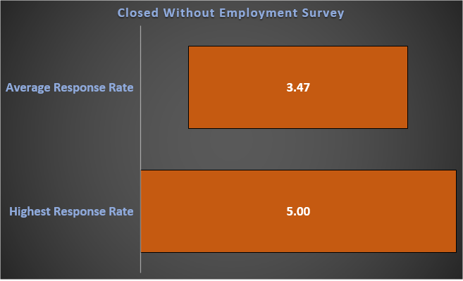
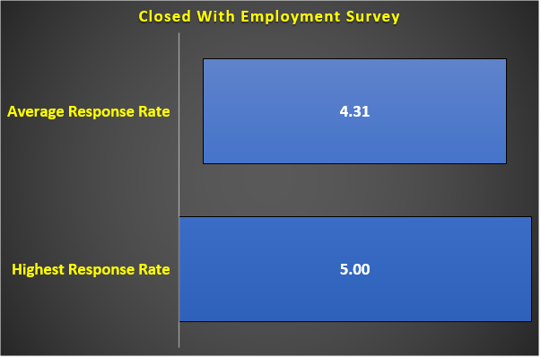
How Likely Would You Be to Refer A Friend Of Family Member to DVRS?
1 Star indicating Not at All and 5 stars indicating Extremely Likely
Notes:
Average response rate was 69% for how likely would you refer a friend of family member to DVRS across both closed case types (with and without employment).

Slide 27
Employment and Referment Summary
Currently Employed:
Closed with Employment: 91% of respondents mentioned that they were currently employed.
Closed without Employment:71% of respondents mentioned that they were not currently employed.
Satisfaction with Job:
Closed with Employment: Respondents reported an average of 4.30 for overall satisfaction towards their coworkers.
Refer to DVRS:
Closed with Employment: Respondents reported an average of 4.31 for referring DVRS to a friend or family member.
Closed without Employment: Respondents reported an average of 3.47 for referring DVRS to a friend or family member.
Based on the highest response rate from each question for each corresponding survey

Slide 28
Strengths, Challenges and Areas for Improvement
What Else Would You Like To Share about Your Current Job?
Some strengths and challenges according to this question:
Enjoyment of the job, having supportive colleagues and finding work meaningful
Grateful to obtain assistance in identifying the career interests that aligned with strengths
Dissatisfied with insufficient wages or hours to support themselves in job
Mixed reactions about how disability may affect performance in the workplace
With regards to these strengths and challenges, DVRS acknowledges the positive contributions for assisting individuals in finding careers that are purposeful and aligns with their strengths. DVRS is additionally committed to following up with consumers in finding work that can support them financially, along with providing strategies in helping with their overall performance at their job.
*This question only appeared on the closed with employment survey

Slide 29
Challenges and Areas for Improvement
Question: What Else Would You Like To Tell Us about Your Time with DVRS. Feel Free To Comment
Both surveys displayed the following challenges:
Negative experiences with counselors
Issues pertaining to professionalism and communication between counselors and consumers
Slow and long process
Job coaches needing specialized training to work with individuals with specific types of disabilities
Consumers indicating that they found their job independently without the help of DVRS
DVRS acknowledges these findings as opportunities for strategic improvement; this includes remaining steadfast with enhancing communication protocols and overall experiences between counselors and consumers, accelerating DVRS meeting processes’, addressing disability-related concerns, and assisting consumers with employment placement support to support their needs.

Slide 30
Strength Related Areas
Question: What Else Would You Like To Tell Us about Your Time with DVRS. Feel Free To Comment
Both surveys displayed the following strengths:
Positive relationships with counselors
Receiving assistive technology (van modifications, hearing aids) that can help consumers maintain independence and employment
Overly satisfied with the value that DVRS provides (It was definitely a very valuable service, and I recommend it to anyone who is having difficulty finding a good Job…)
DVRS recognizes the positive contributions that consumers had with their counselors, the role assistive technology can support with workplace success and independence, along with providing an overall satisfactory value. DVRS is committed to ensuring that these strengths continue when consumers are receiving any necessary services.

Slide 31
Strengths, Challenges and Areas for Improvement
Which Services from DVRS Helped You Find A Job?
Both surveys displayed the following strengths and challenges:
Obtaining assistance in other job-related capacities (assistance from job coach, looking for jobs, benefits counseling)
Providing and paying for assistive technology & services; hearing aids, driving classes and headphones
Some respondents indicated that DVRS did not help them find a job; consumers found employment independently or through personal connections
DVRS actively encourages consumer feedback and remains committed to reviewing and incorporating it to enhance service delivery.

Slide 32
What Does DVRS Do with the Responses?
Once survey results are collected, the qualitative responses for both Closed with Employment and Closed without Employment are gathered
  Qualitative responses included respondents’ comments, thoughts and opinions
The Quality Assurance Unit sends qualitative responses to the corresponding Field Office (Manager, Supervisor and Field Chief)
Staff is asked to follow-up with any necessary action

Slide 33


